Slide 1

Experiments on Question Answering task with SQuaD CSI5180 Virtual Assistants
Group 16
Rakshil Kevadiya (300282913)
Neel Patel (300211968)

Slide 2
Content
Project Summary
Methodology
Activity Table
Results
Challenges
Lessons Learnt
Conclusion

Slide 3
Project Summary
Question Answering on the SQuaD dataset
Compare various methods on Seq2Seq data
Gain insights on the task & understand its complexity
Deliverables
Knowledge gained and applied from literature review
Understandings from the SQuaD dataset
Code and result analysis from of the task
** We do not intent to produce SOTA results
Notes:
Through this project we aim to solve the Question Answering task on the squad dataset using Deep Learning
More specifically we intend to apply various DL methods on the squad dataset and compare their performance
Our primary object is to gain insights into the task and complexity of the approach required to solve it.
In terms of deliverables for the project, we involve literature review of the existing research in this area. Which enabled us to better understand the task of Question Answering on the SQuAD dataset, as well as the different approaches that have been used to solve it.
Our final deliverable will include the code we used to perform the experiments and the results of our analysis.

Slide 4
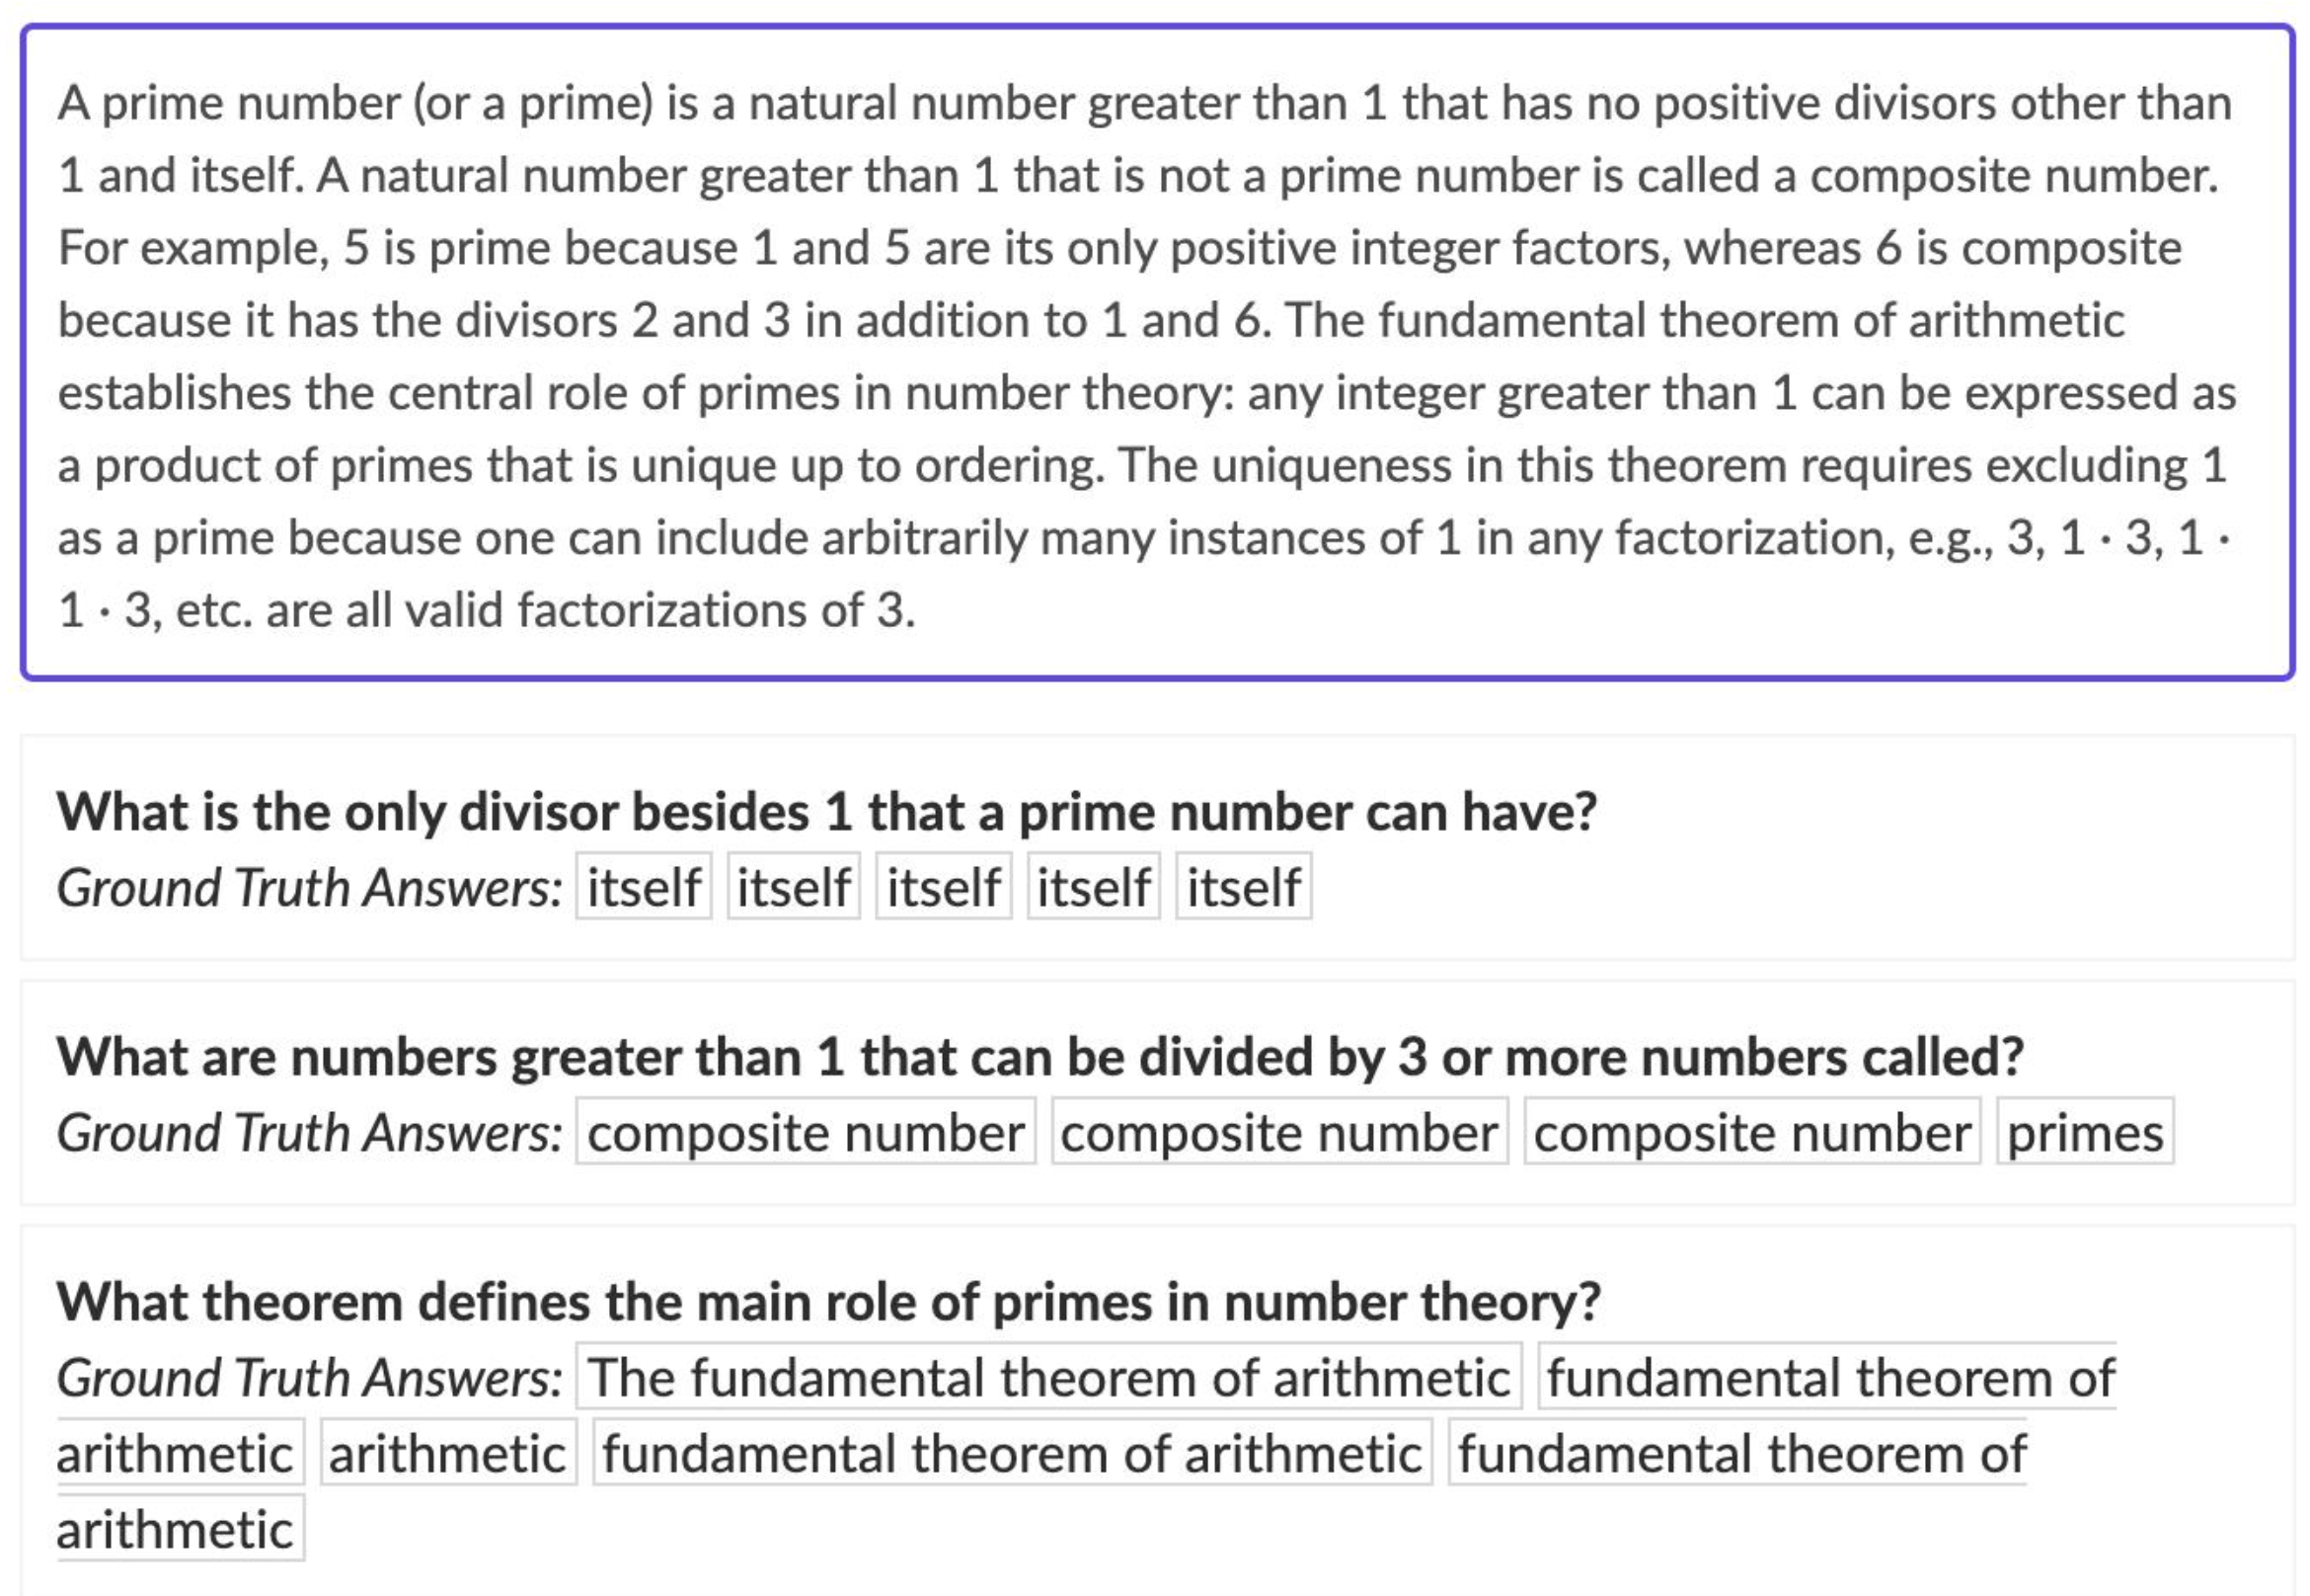
Methodology
DATASET
Stanford Question Answering Dataset (SQuaD)
Popular benchmark dataset for Q/A
Consists of Wikipedia articles & corresponding Q/A
Questions are posed by Crowdsource workers
Answer is a segment of text (span) from the corresponding passage
or the question might be unanswerable.
The Stanford Question Answering Dataset (rajpurkar.github.io)
Notes:
In order to achieve our goal of question answering on the SQuAD dataset, we first needed to understand the dataset itself. SQuAD, or the Stanford Question Answering Dataset, is a popular benchmark dataset for question answering.
It consists of a large set of Wikipedia articles and corresponding questions and answers, with the task being to predict the answer to a given question based on the article.
Questions are posed by crowdworkers, where the answer to every question is a segment of text, or span, from the corresponding reading passage, or the question might be unanswerable.

Slide 5
Methodology
ALGORITHMS – BERT (Bidirectional Encoder Representations from Transformers)
A pre-trained language model that uses a Transformer architecture to learn contextual relationships between words in a sentence.
Serves as a Swiss army knife solution to many common language tasks.
Can be fine-tuned on many diverse tasks with high accuracy.
Produced SOTA results when released, on many tasks;
5.1 relative improvements on the F1 Score for Q/A task on the SQuaD v2.0
BERT: Pre-training of Deep Bidirectional Transformers for Language Understanding https://arxiv.org/pdf/1810.04805.pdf | BERT Models Applications: Question Answering System https://link.springer.com/chapter/10.1007/978-1-4842-6664-9_5#DOI
Notes:
After gaining an understanding of the SQuAD dataset and the existing methods for question answering through our literature review, we identify and apply various algorithms on the Q/A task.
Namely; BERT, BIDAF and XLNet
We do not intent to explain the architectures of these ubiquitous methods, we intent to identify the adoptability of these methods for the Q/A task.

Slide 6
Methodology
ALGORITHMS – BiDAF (Bidirectional Attention Flow)
Designed for Machine Comprehension tasks
Uses a bi-directional attention flow mechanism to improve its efficacy.
which is helpful in Q/A tasks because it allows the model to better understand the context and query and their interactions.
BiDAF differs from BERT
BiDAF uses both character & word level embeddings
Bi-directional Attention Flow for Machine Comprehension https://arxiv.org/pdf/1611.01603.pdf | Question Answering on SQuaD 2.0 https://web.stanford.edu/class/archive/cs/cs224n/cs224n.1194/reports/default/15839661.pdf
Notes:
MC involves answering a query about a given context paragraph and requires modeling complex interactions between the context and the query.
the bi-directional attention flow mechanism refers to the process of jointly modeling the context (in this case the document containing the answer) and the query (question being asked) to compute the query-aware context representations.
Similar to BERT, according to the authors, BIDAF also achieves good results on the Q/A task, which was an inspiration to include it in our study.

Slide 7
Methodology
ALGORITHMS – XLNet
XLNet is a generalized autoregressive pretraining method.
Like the BERT model it uses a Transformer architecture
Unlike the BERT & BiDAF models, XLNet relies on permutation-based training
XLNet outperforms BERT on many language tasks
F1 score of 90.68 as compared to 83.06 of BERT on SQuaD 2.0
This superiority at dealing with longer context could come from the Transformer-XL backbone in XLNet.
XLNet: Generalized Autoregressive Pretraining for Language Understanding https://arxiv.org/abs/1906.08237
Notes:
XLNet is a generalized autoregressive pretraining method, it leverage the best of both autoregressive language modeling and autoencoding while avoiding their limitations.
Like the BERT model it uses a Transformer architecture, unlike the BERT & BiDAF models XLNet relies on permutation based training, which enables the model to learn from all possible permutations of the input sequence, rather than just the left-to-right and right-to-left orders as in traditional autoregressive language models
XLNet outperforms BERT on many language tasks, as stated by the authors this superiority at dealing with longer context could come from the Transformer-XL backbone in XLNet.
Transformer-XL is a type of neural network architecture that was designed to improve the performance of autoregressive models on long-range dependency tasks

Slide 8
Activity Table
The following are rough estimates of total time dedicated for each activity, by the team.
Literature Review | Dataset Exploration | Data Preprocessing | Understanding Model Architectures & Implementations | Training & Hyperparameter Tuning & Result Analysis | Presentation & Code Formatting
5Hr | 4Hr | 2Hr | 15+Hr | 25+Hr | 7Hr
 | Understanding the SQuaD dataset and exploring its various versions. | Exploration of various techniques to transform original text to efficient features. | Time consuming due to lack of computing power. Training 1 epoch takes ~2hr on GPU enabled Google Colab environment. 10 epochs per model = ~20Hr 20 * 3 = ~60H (for training)
** Despite our best efforts we were not able to get results for the BiDAF model; the following were tried
BiDAF implementation from the allennlp package
BiDAF implementation from TensorFlow v1
BiDAF implementation from PyTorch v0.4.0

Slide 9
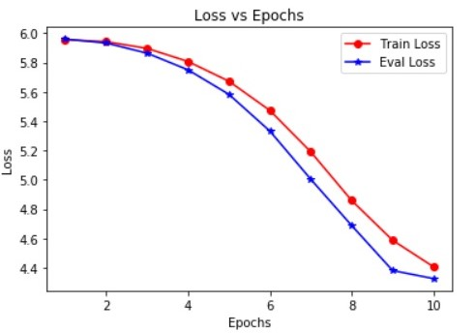

Results
Quantitative
BERT – Loss vs Epochs
Evaluation Metrics
Model | Accuracy |  |  | F1-Score
 | Top-1 | Top-3 | Top-5 | Top-1 | Top-3 | Top-5
BERT | 0.071 | 0.174 | 0.255 | 0.071 | 0.087 | 0.085
BERT* | 0.527 | 0.755 | 0.826 | 0.52 | 0.377 | 0.275
XLNet | 0.472 | 0.653 | 0.713 | 0.472 | 0.326 | 0.237
* model has pretrained weights (already fine-tuned on SQuAD, included only for comparision.

Slide 10
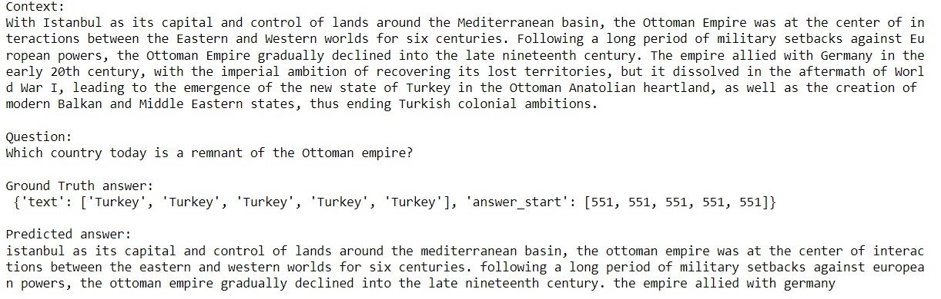
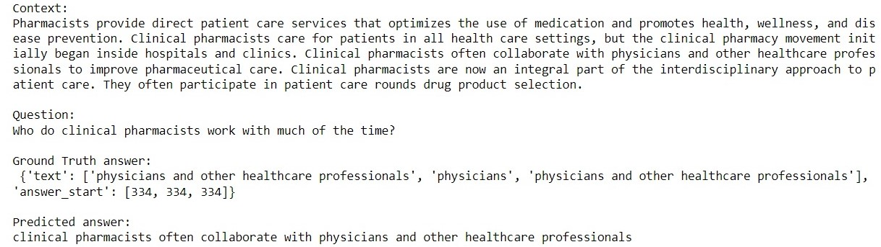
Results
Qualitative
Incorrect Prediction
Correct Prediction

Slide 11
Challenges
Gaining in-depth knowledge on the Q/A task
Understanding complex NLP model architectures
Limited computational resources
Optimizing models for comparative results
Availability of Implementation for BiDAF (Bi-Directional Attention Flow)
Notes:
In general, it is vital to have a proper background for the task on hand, for instance, Q/A systems can be open or closed domain. The questions posed can be factoid or non-factoid, thus it is essential to have an in-depth knowledge on the Q/A task.

Slide 12
Lessons Learnt
Gained valuable knowledge on Q/A systems.
Understood the limitations of RNN & LSTM models for Q/A task.
Pre-trained models like BERT, BiDAF, and XLNet have shown state-of-the-art performance in various NLP tasks, including Q/A.
Gained experience on fine-tuning pre-trained models.
Appreciate the open-source adaptability of NLP models and datasets.
Notes:
- Difficulty in modeling long-term dependencies: RNNs and LSTMs have difficulties in modeling long-term dependencies in text data, which can be a major limitation for Q/A tasks that require understanding of the context and relationships between different parts of the text.

Slide 13
Conclusions
Explored different models for Q/A task on the SQuAD dataset, including BERT, BiDAF, and XLNet.
Learnt the limitations of models with short term memory on Q/A tasks.
Permutation-based training used in XLNet improves the ability of the model to handle complex dependencies between words and results in better performance compared to BERT and BiDAF.
Gained knowledge on the SOTA results for the Q/A
Elevated significane of availability of high computing power to carry out such tasks.

Slide 14
Resources
https://rajpurkar.github.io/SQuAD-explorer/ (SQuaD dataset)
https://medium.com/analytics-vidhya/encoder-decoder-seq2seq-models-clearly-explained-c34186fbf49b
https://paperswithcode.com/dataset/squad (Studies on the SQuaD dataset)
https://arxiv.org/abs/1810.04805 (BERT)
https://link.springer.com/chapter/10.1007/978-1-4842-6664-9_5#DOI (BERT for Q/A)
https://arxiv.org/pdf/1611.01603.pdf (BiDAF)
https://web.stanford.edu/class/archive/cs/cs224n/cs224n.1194/reports/default/15839661.pdf (BiDAF for Q/A)

Slide 15
THANK YOU!

